Slide 1
Xamarin.Forms 3. predavanje
Ivan Čuljak

Slide 2
Animations

Slide 3
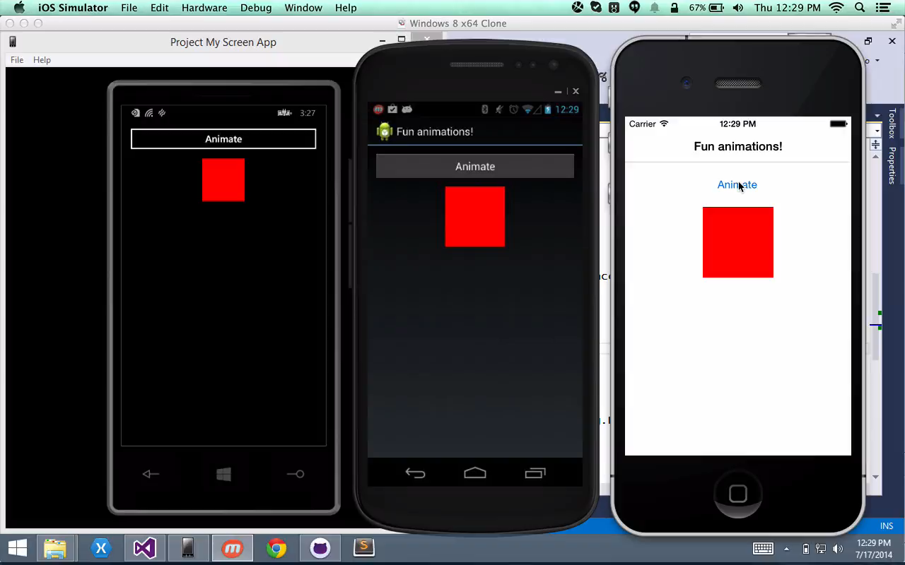
www.github.com/JamesMontemagno/FormsAnimations
Notes:
Xamarin.Forms has a complete cross platform animations api as well. It takes advantage of the underlying APIs on each platform such as CoreAnimation on iOS.
Additionally, it is completely asynchronous with an async/await api.

Slide 4
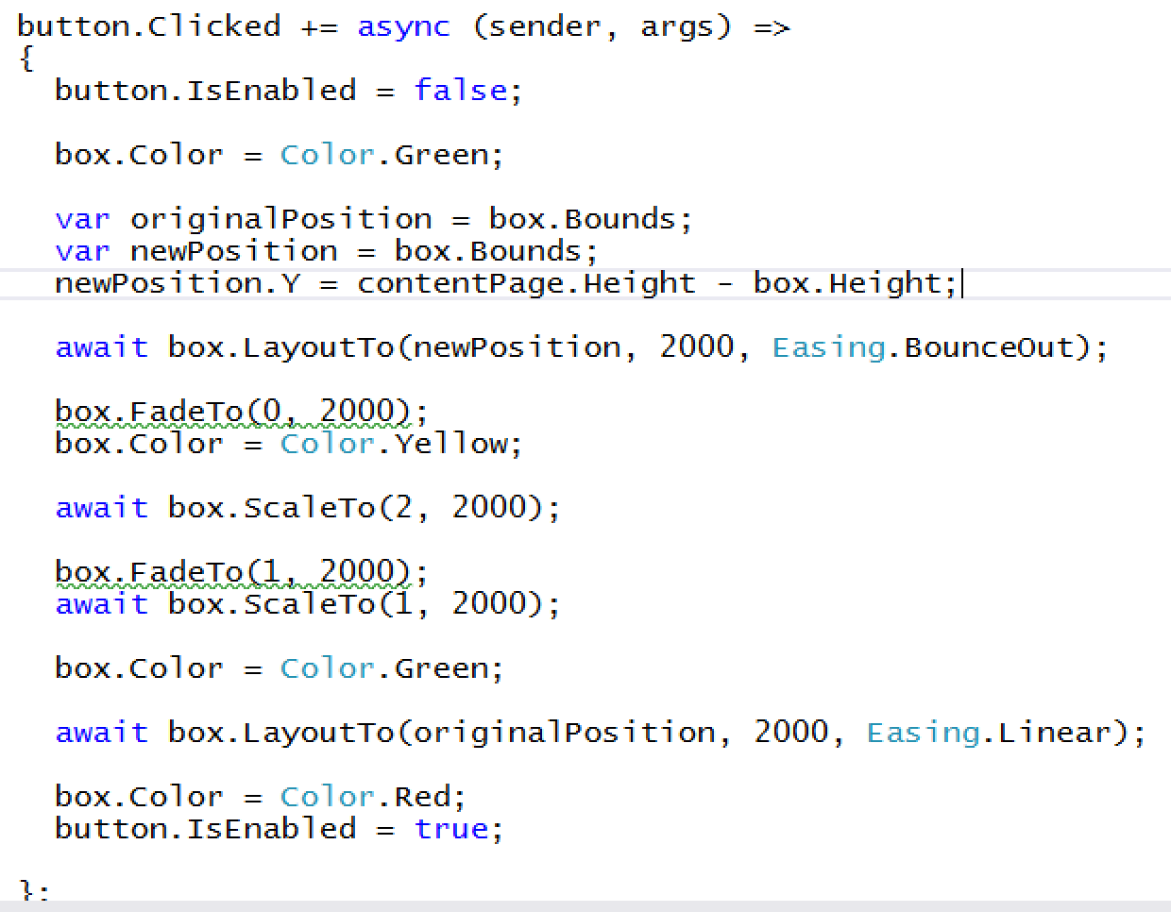
Notes:
Here we can see we have our event for the button click.
We first disable the button and set the box to Green.
We save out the location and set a new location to drop to the bottom of the page and bounce.

Slide 5
Notes:
We await for that to finish and start to fade out the box, change the color to yellow.
Then we scale the box up, wait for that to finish and scale it back down.

Slide 6
Notes:
After that is completed we move it back to the original position linearly.
After that completes we set the box back to red and enable our button again.
Let’s see what it looks like one more time.

Slide 7
www.github.com/JamesMontemagno/FormsAnimations

Slide 8
Behaviors

Slide 9
Triggers

Slide 10
Effects

Slide 11
Custom renderers

Slide 12

Extensibility
Step 1: Custom Xamarin.Forms Control
Notes:
First we will create our own Xamarin.Forms control in our shared code. In this case we are simply inheriting from “Entry”, however you can even inherit from View which can be anything.
Optional: Add custom properties and bindings

Slide 13
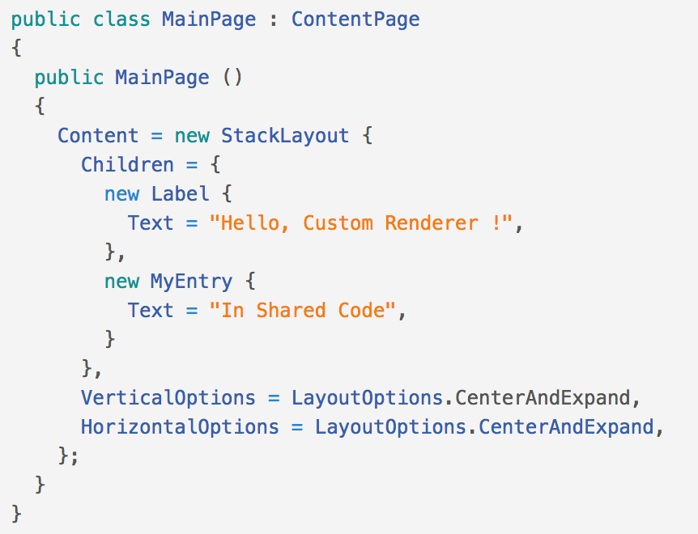
Extensibility
Step 2: Use Custom Control in our shared Pages
Notes:
We can simply reference and use this new custom control like any of the other control that come out of the box.

Slide 14
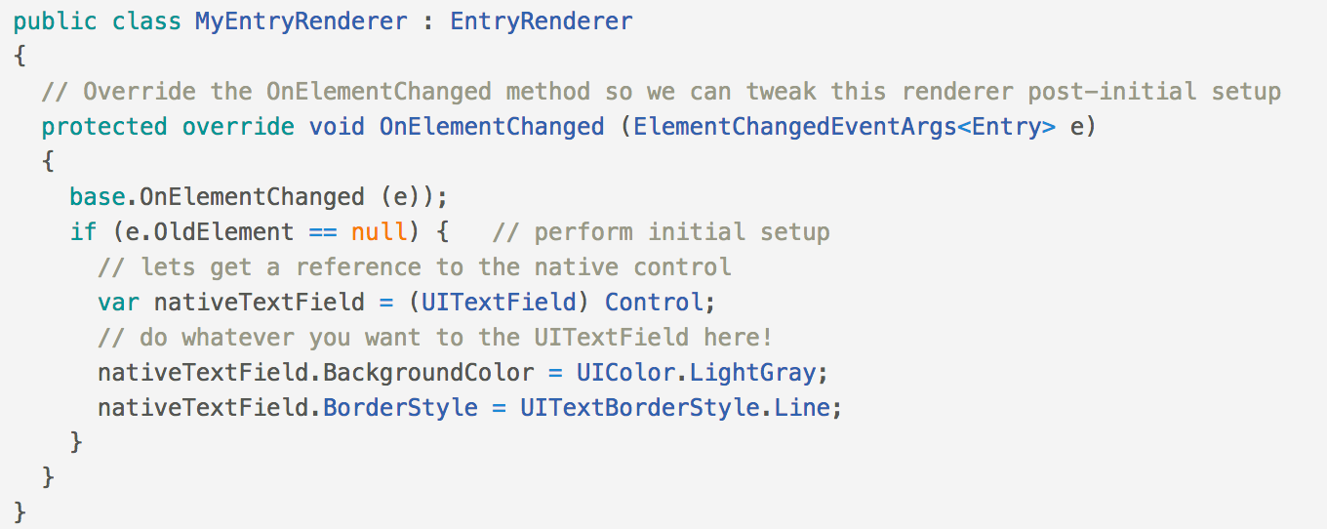
Extensibility
Step 3: Implement Custom Renderer
Notes:
As I mentioned earlier each Xamarin.Forms control has a custom renderer that knows how to “render” and display the native control.
Each Xamarin.Forms control has a Renderer that we can inherit from (including “View” for our custom controls that we might have purchased or created).
Here we will inherit from EntryRenderer and customize the actual UITextField control and set the border style and background color.

Slide 15
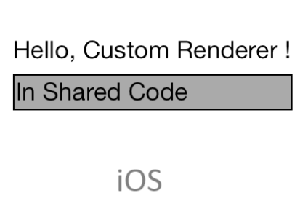
Extensibility
Step 4: Export Renderer
Notes:
The last thing to do is add an export assembly attribute and we are done!

Slide 16
Messaging Center

Slide 17

Messaging Center
MessagingCenter.Subscribe<T>(object subscriber, string message, Action<T> callback);
MessagingCenter.Send(T item, string message);

Slide 18
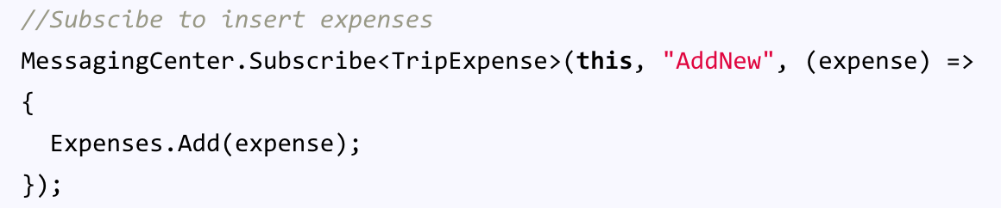
Messaging Center
Master Page:
Detail Page:

Slide 19
Dependency Service

Slide 20
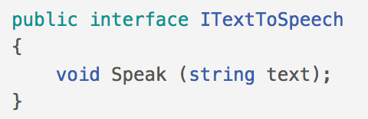
Extensibility
Step 1: Interface
Notes:
First step for using the the Dependency service is to setup an Interface that is accessible from your shared code.

Slide 21
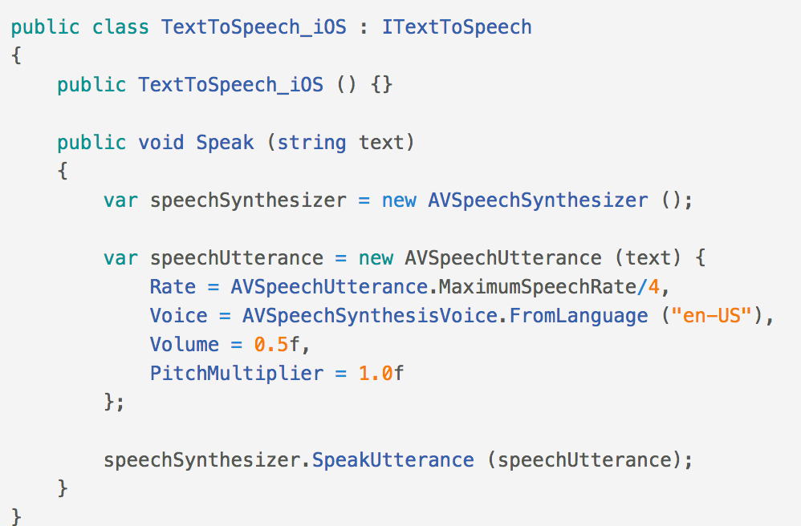
Extensibility
Step 2: Implement on each Platform
Notes:
For each platform we plan to support (iOS, Android, and Windows Phone), we will implement the native functionality. For instance here, we are using AVSpeechSynthesizer on iOS to perform TextToSpeech

Slide 22
Extensibility
Step 3: Register with Dependency Service
Notes:
The built in dependency service uses an assembly attribute to know what class to use for the interface implementation.

Slide 23
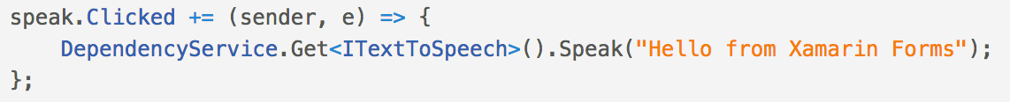
Extensibility
Step 4: Access from shared code
Notes:
The dependency service allows you to easily resolve your interface for the platform specific implementation. Here we are playing back “Hello from Xamarin Forms” when we click a button.

Slide 24
Plugins

Slide 25
Plugins for Xamarin
github.com/xamarin/plugins
Common API
Notes:
This is what Plugins for Xamarin are for! 1 API for all common APIs:
Camera
GPS
Settings
Notifications
Battery
And so much more!

Slide 26
Text To Speech
AVSpeechSynthesizer
public void Speak (string text)
{
var speechSynthesizer = new AVSpeechSynthesizer ();
var speechUtterance = new AVSpeechUtterance (text)
{
Rate = AVSpeechUtterance.MaximumSpeechRate/4,
Voice = AVSpeechSynthesisVoice.FromLanguage ("en-US"),
Volume = 0.5f,
PitchMultiplier = 1.0f
};
speechSynthesizer.SpeakUtterance (speechUtterance);
}
Notes:
For iOS we would call into the Text to Speech AVSpeechSynthesizer API

Slide 27
Text To Speech
TextToSpeech
TextToSpeech speaker;
string toSpeak;
public void Speak (string text)
{
toSpeak = text;
if (speaker == null)
{
speaker = new TextToSpeech (ctx, this);
}
else
{
var p = new Dictionary<string,string> ();
speaker.Speak (toSpeak, QueueMode.Flush, p);
}
}
public void OnInit (OperationResult status)
{
//… more stuff
}
AVSpeechSynthesizer
Notes:
For Android, it is a bit longer and I couldn’t’ fit it all into a single slide for the TextToSpeech API

Slide 28
Text To Speech
SpeechSynthesizer
public async void Speak(string text)
{
SpeechSynthesizer synth = new SpeechSynthesizer();
await synth.SpeakTextAsync(text);
}
Notes:
Then Windows is actually pretty simple with just a few lines of code. However, what happens when I want to actually call text to speech from my shared code?

Slide 29
Common Interface?
ITextToSpeech
public interface ITextToSpeech
{
void Speak (string text);
}
Notes:
Well I would have to create an interface and then use my favorite Dependency Service such as MvvmLight or Xamarin.Forms built in Dependency Service to grab it. This is just 1 method, what happens when I want to extend it to gather the available languages, or see when the speech is starting or stopping? This will get really messy real quick.

